Slide 1
Penalty Kick
Lesson 6

Slide 2


Review

Slide 3
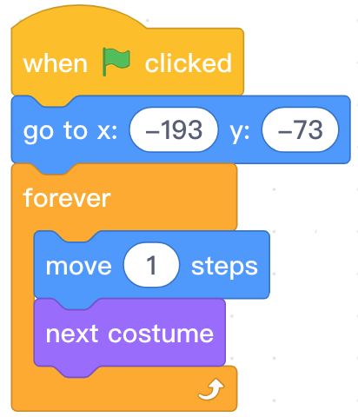
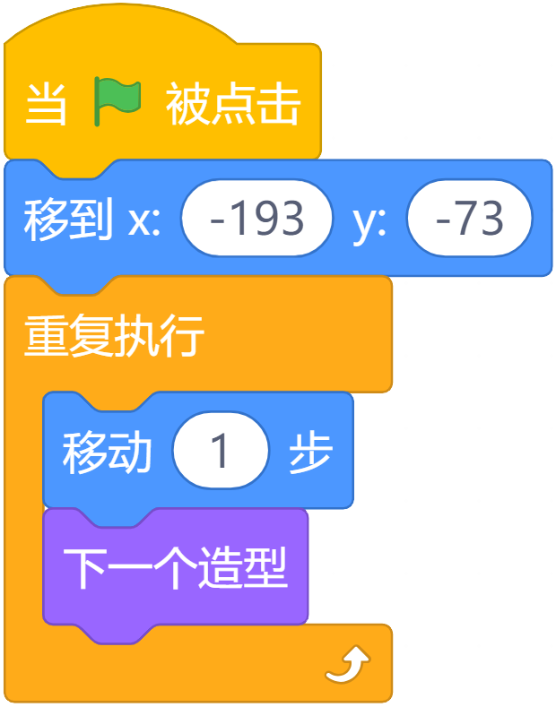
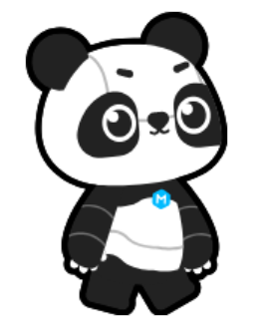
Review
Role | Block | Effect
After the green flag is clicked, the panda will move to the starting point, and then repeat the action of moving forward and changing costume.

Slide 4
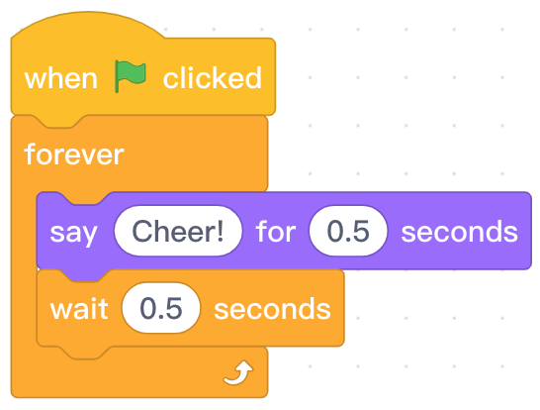
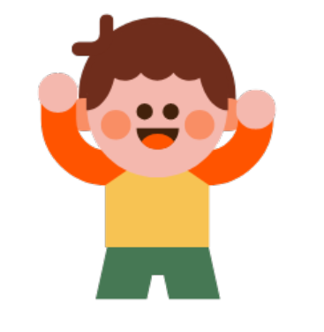
Review
Role | Block | Effect
When the green flag is clicked, say “Cheer!” for 0.5 seconds every 0.5 seconds.

Slide 5
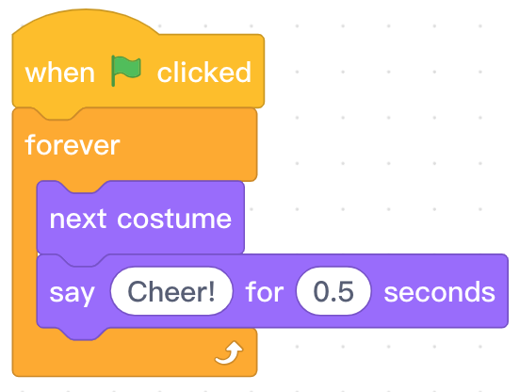
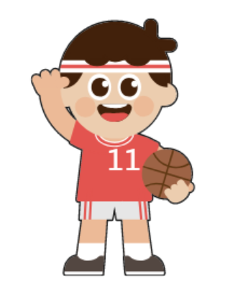
Review
Role | Block | Effect
After the green flag is clicked, repeatedly switch the costume and say “Cheer!” for 0.5 seconds.

Slide 6
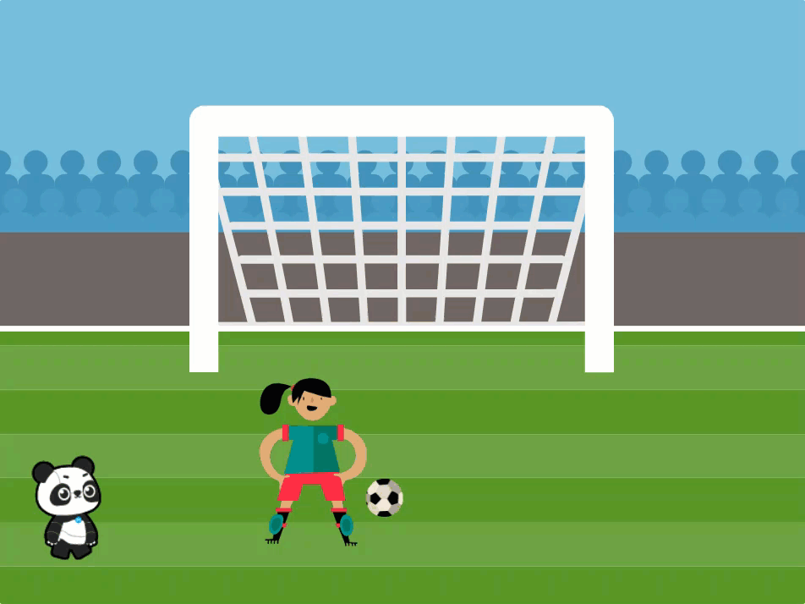

Slide 7
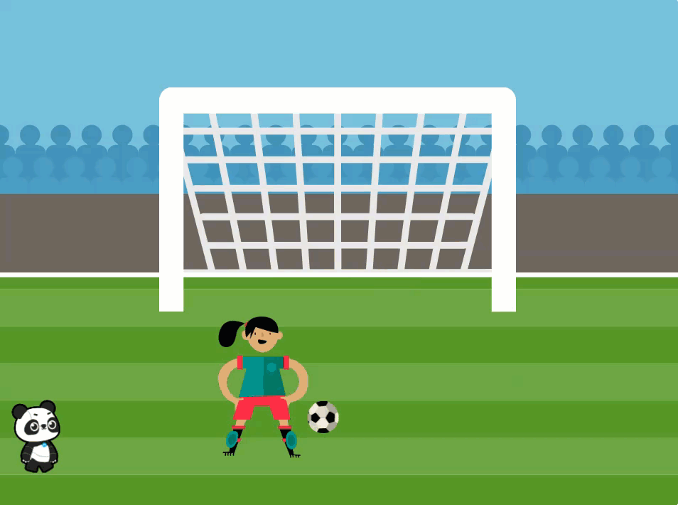
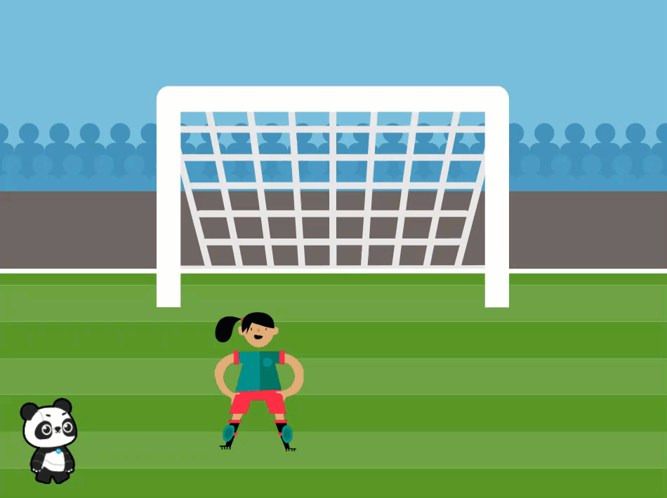
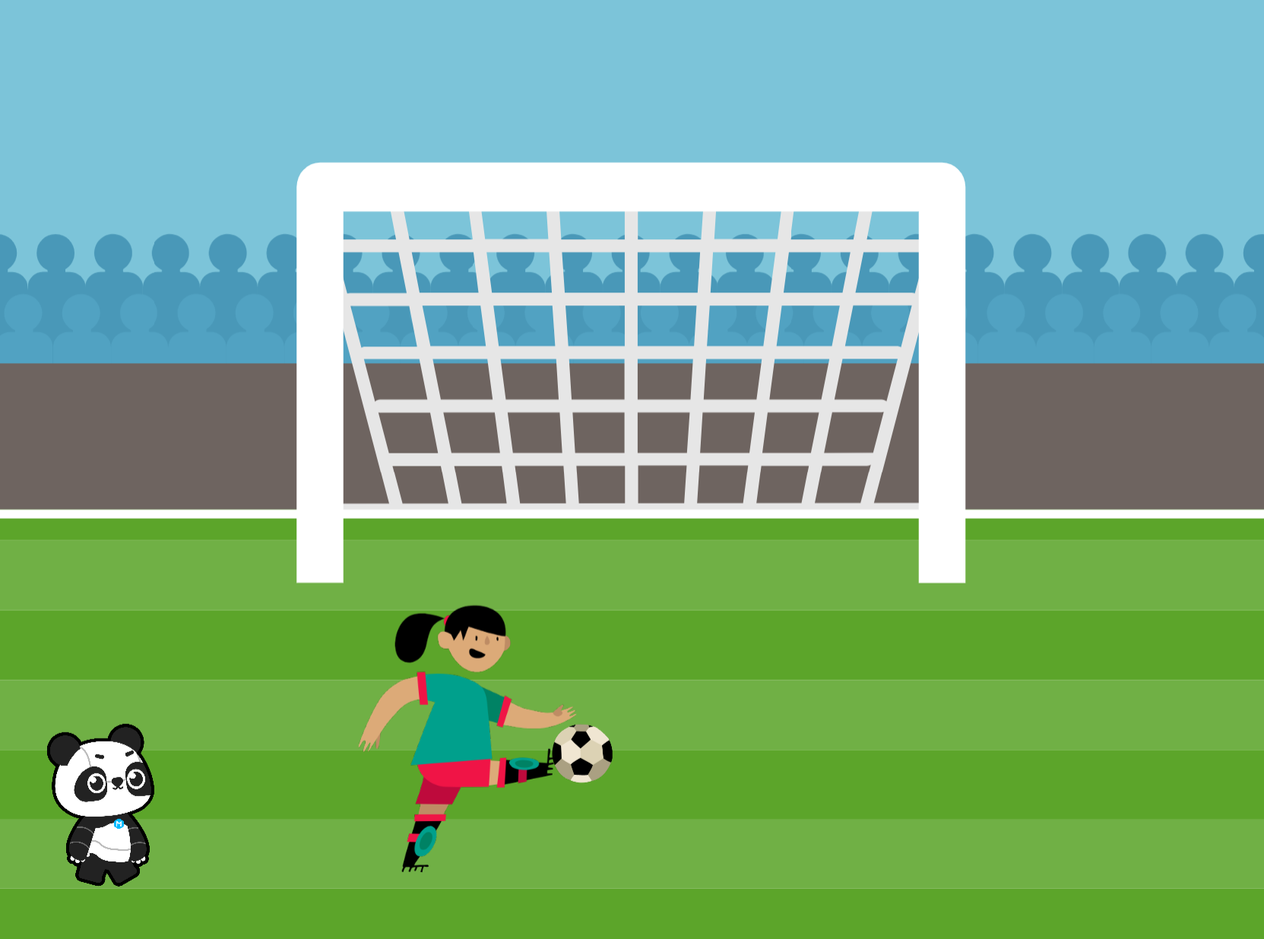
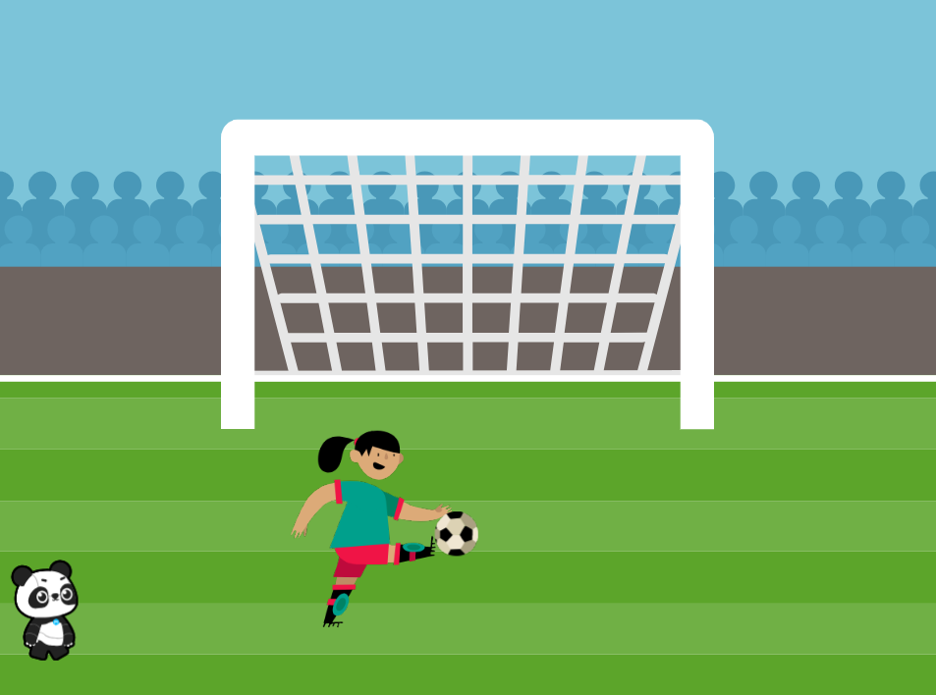
Ball is Kicked into the Goal
Ball is Kicked into the Goal

Slide 8
Hands On

Slide 9
Change the Size of a Sprite

Slide 10
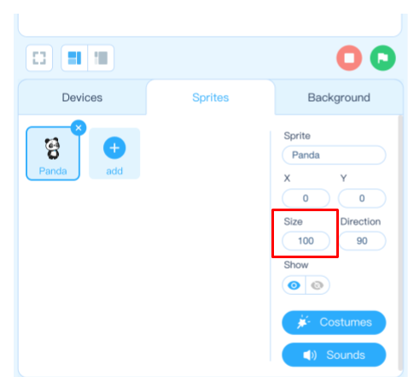

Slide 11
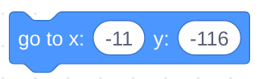
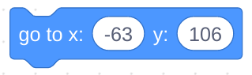
Step 1: Open the mBlock software. Create a new file.
Step 2: Add the “Football field1” background to the program.
Step 3: Change the Panda size to 50 and drag Panda to the lower left corner of the stage.
Step 4: Add the “Soccer Ball” sprite to your program.
Step 5: Change the soccer ball size to 50 and set the starting position for the Soccer Ball using these coordinates:
Step 6: Add the “Jordyn” sprite to your program.
Step 7: Change Jordyn’s size to 80 and set the starting position using these coordinates:

Slide 12
Switch Costumes

Slide 13
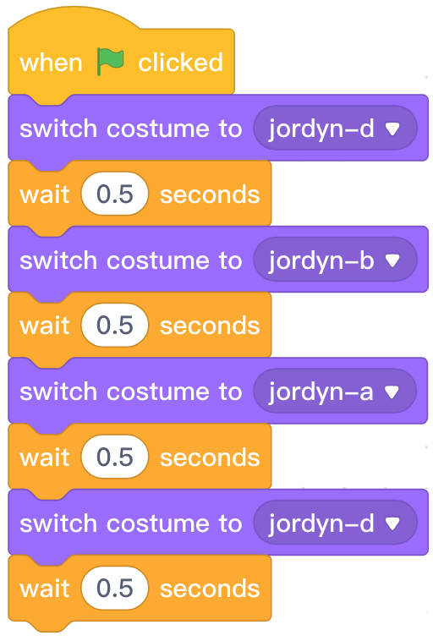

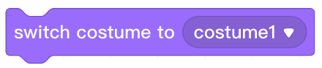
Programming knowledge
Block area | Block | Function | Example
Control the sprite to change its costume into the specified costume.

Slide 14
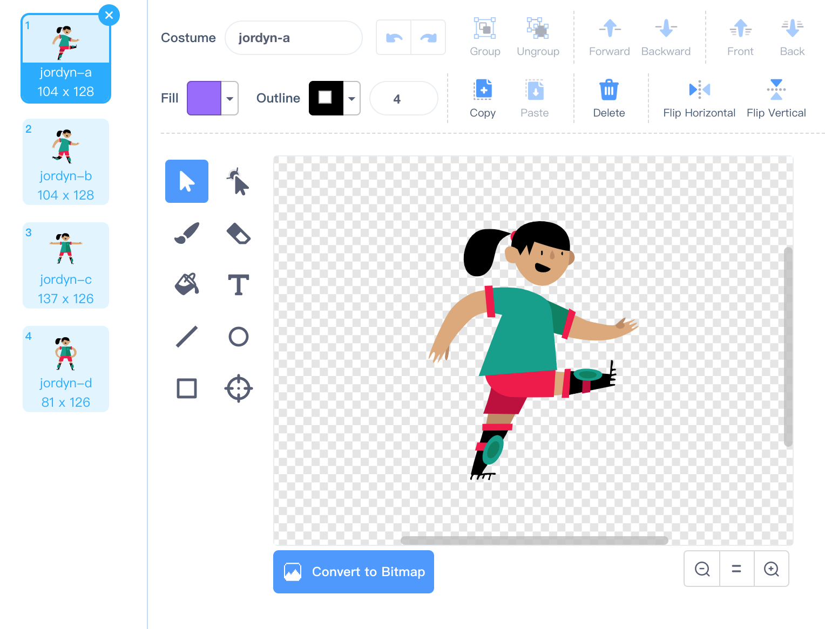

Slide 15
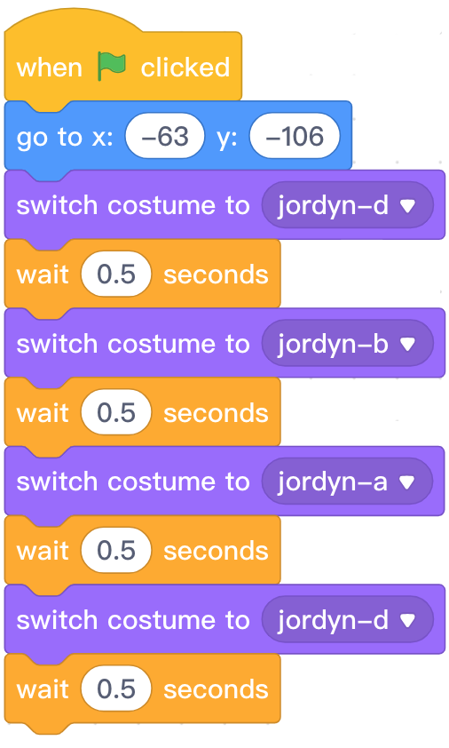
Step 1: In the Sprites tab in the Stage Area, select the Jordyn sprite to ensure that we are programming on this sprite.
Step 2: Find and select the appropriate blocks from the Block Area to create the following program:

Slide 16
Moving a Sprite with Glide

Slide 17
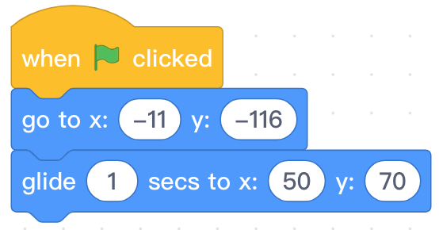

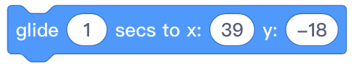
Programming knowledge
Block area | Block | Function | Example
Moves smoothly to a specified position at the stage in a specified time.

Slide 18
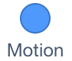
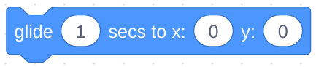
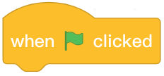
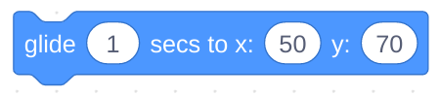
Step 1: In the Sprites tab in the Stage Area, select the Soccer Ball sprite to ensure that we are programming on this sprite.
Step 2:Find and select from the Block Area. Click and drag the block to the Script Area and attach it beneath a block. Change the block to the following coordinates and duration:
Step 3: Ensure the Soccer Ball contains the following program:

Slide 19
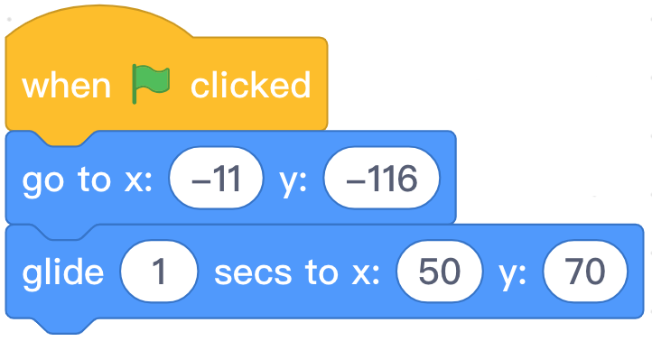
Step 5: Start the program by clicking the green flag

Slide 20


After running the program, are there any small problems? Can you come up with a solution?
Try to change my program.

Slide 21
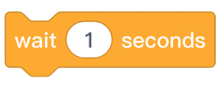
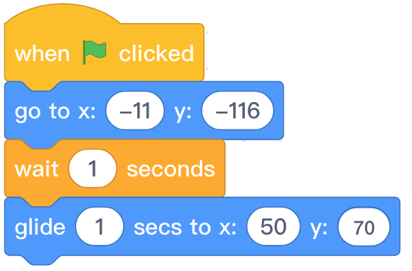
Step 4: When running the program you will find that the kicking action of the player and the movement of the soccer ball are not synchronized. Correct synchronization occurs when the player makes the “kicking” animation and the ball begins to roll. We can use the block to solve this problem.

Slide 22
Show and Hide

Slide 23
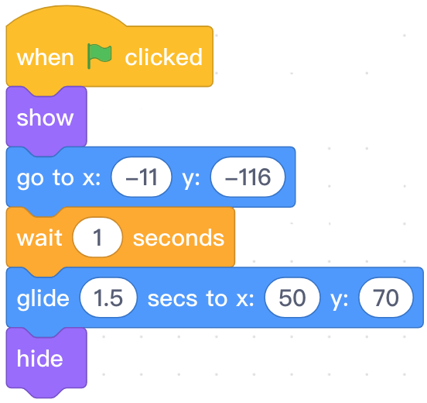



Programming knowledge
Block area | Block | Function | Example
Display the hidden sprite.
Hide the sprite.

Slide 24
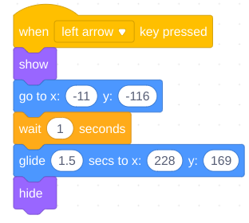

Step 1: In the Sprites tab in the Stage Area, select the Soccer Ball sprite to ensure that we are programming on this sprite.
Step 2: Find and select the appropriate blocks from the Block Area to create the following program:
Step 3: Click the in the Stage Area to run the program where Jordyn kicks the ball into the goal.
Step 4: Identify two problems with your program.

Slide 25
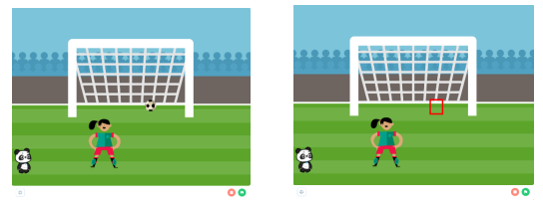
Problem 1:
Soccer Ball is still hidden.

Slide 26
Step 1: In the Sprites tab in the Stage Area, select the Soccer Ball sprite to ensure that we are programming on this sprite.
Step 2: Modify the first program to include the block as indicated below:

Slide 27
Problem 2:
Jordyn does not change costumes when the left arrow key is pressed.

Slide 28
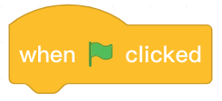
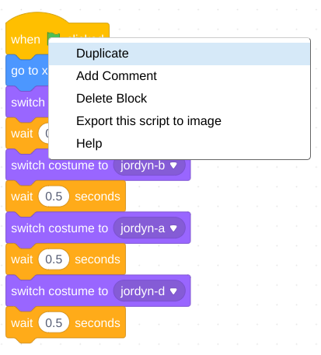
Step 1: In the Sprites tab in the Stage Area, select the Jordyn sprite to ensure that we are programming on this sprite.
Step 2: Right-click on the block in the Script Area and select Duplicate. Release the copy of the program in the Script Area.

Slide 29
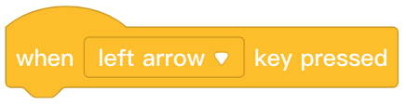
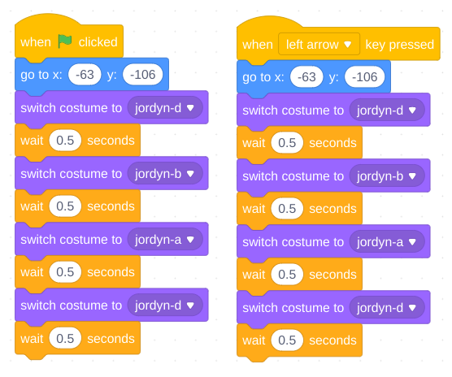
Step 3: Modify the program to be triggered by the block. There should be two programs on the Jordyn sprite.

Slide 30
Let’s try!

Slide 31
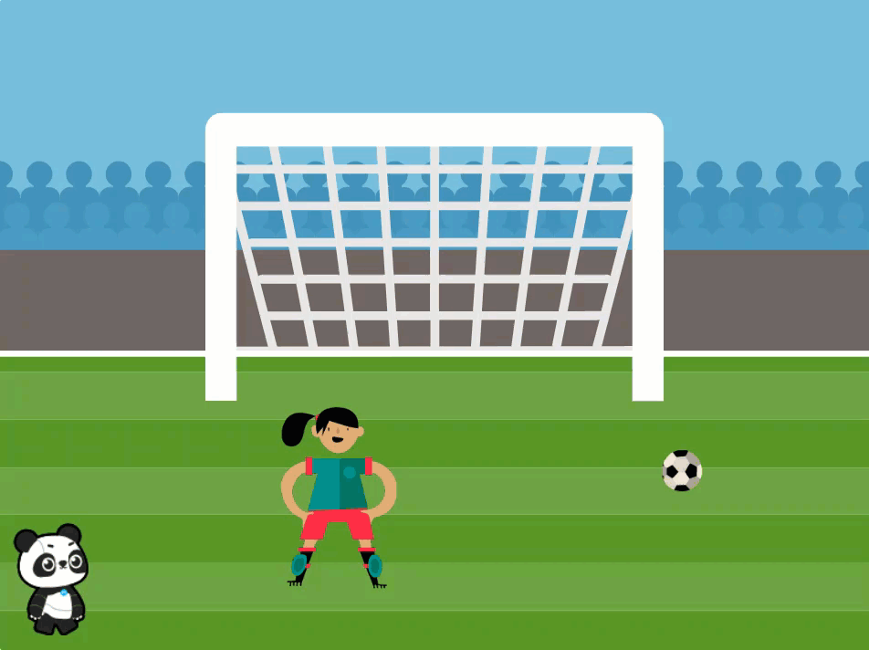
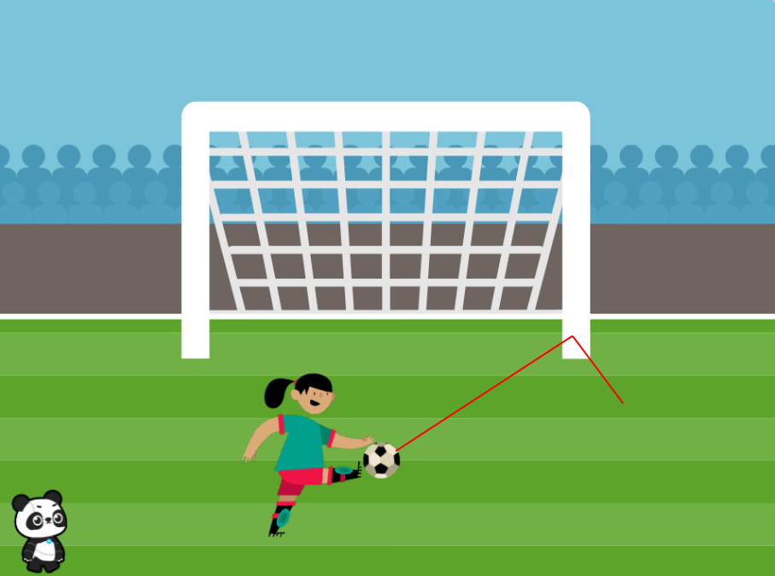
Ball is Kicked into the Goal
Ball Hits the Goalpost

Slide 32
Independent Practice
Penalty Kick
Instruct the students to complete the program, Penalty Kick. Their final project should do the following:
The ball is kicked into the goal by pressing the space key.
The ball hits the post by pressing the right arrow key.

Slide 33
Extension
Challenge students with remaining time to do one or more of the following:
Program the ball to rebound once it hits the goalpost.
Program Panda to ask Jordyn to show how to kick the ball.
Program Jordyn to kick the soccer ball to Panda.

Slide 34
Review

Slide 35
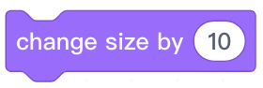
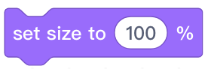
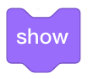
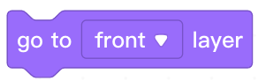
1. Which of the following blocks can display the hidden sprite?
A.
B.
C.
D.
Notes:
Answer: C

Slide 36
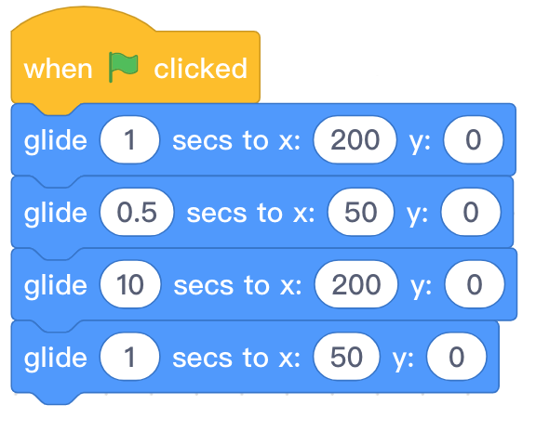
2. When running the code, what will the sprite’s path of movement be?
A. A square
B. A rectangle
D. Move back and forth in a straight line
C. Move right in a straight line
Notes:
Answer: D

Slide 37
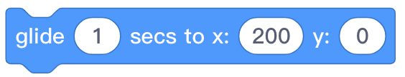
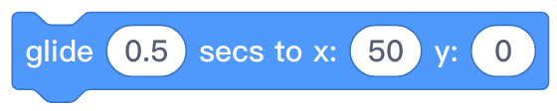
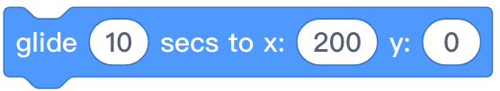
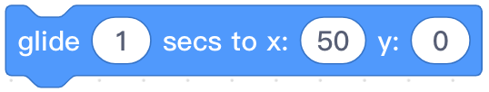
3. When running the code, the sprite will glide 4 times. What is the slowest instruction?
A.
B.
C.
D.
Notes:
Answer: C

Slide 38
Thank you!

